Slide 1
Ask Weber
Session 1: 24/04/2020

Slide 2
Lecture 1

Slide 3
Lecture 2: The Body Normal
What proportion of the human body is fluid?
What total body mass is blood?

Slide 4
What are the compartments of fluid in the human body?

Slide 5
What is the tissue interstitium?

Slide 6
How does fluid and nutrients transfer from the blood/plasma to the cells?

Slide 7
Hard Q: What medical condition indicates for a faecal transplant? Why is it necessary?

Slide 8
What is the mechanism of an autologous bone marrow transplant? Why do we do it?

Slide 9
Given a heart beats 70x/min, how many times would it beat in a year?

Slide 10
How long does cell metabolism continue for after death?

Slide 11
Name 2 structures with a high surface area-volume ratio
What is the biological importance of a high surface area:volume ratio? What are these structures/surfaces typically used for?

Slide 12
What is the causative agent of tetanus? How does it act?
What are the signs of tetanus?
What is the reason for reducing rates of tetanus (essentially eradicating this disease?)

Slide 13
What is the causative agent of diphtheria, and how is it transferred? What is the primary reason for its low occurrence?

Slide 14
Lecture 3: Let’s start with this one?

Slide 15
Describe the function of the following (in 1 sentence), as well as any substructures contained within them
Nucleus
Nucleolus
Rough endoplasmic reticulum
Smooth endoplasmic reticulum
Golgi complex
Mitochondria
Lysosomes
cytoskeleton

Slide 16
What is a hormone?

Slide 17
What is particularly important about the structure of the mitochondrial membrane?

Slide 18
When a neutrophil phagocytes an extracellular bacteria, what substructure of the neutrophil is primarily responsible for the destruction of the bacteria?

Slide 19
When a cell signals for apoptotic destruction, what substructure of the cell is primarily responsible for initiating the response?

Slide 20
Which specific ion is important in cellular signalling following fertilisation of an oocyte?

Slide 21
How many layers of phospholipids exist between two separate cells? Between plasma and within an alveolar cell?

Slide 22
What substances are lipid bilayers NOT permeable to? How do these particles get through?

Slide 23
How may layers will a molecule of oxygen have to pass through to get from the alveoli of the lung into a red blood cell?

Slide 24
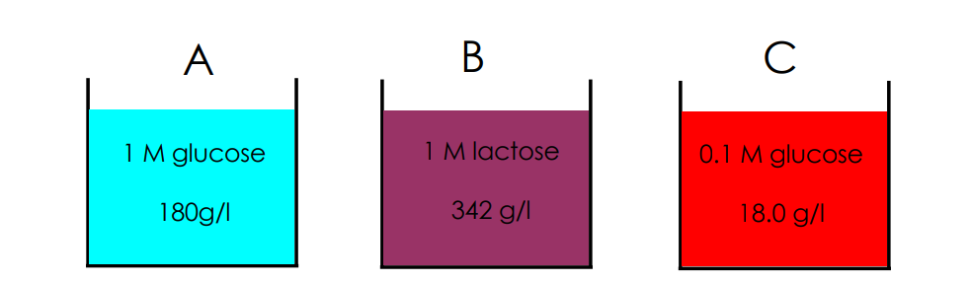
Which direction would water flow if a semipermeable membrane were to be placed between solution B and C?

Slide 25
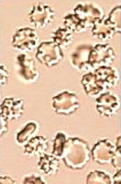
What type of solution (hypotonic, hypertonic, isotonic) would a red blood cell be placed into for the following blood smear to appear?

Slide 26
Does the Na+-K+-ATPase ion channel/transporter act in a passive or active fashion?

Slide 27
True/false: CO2 enters and exits a cell through an active transporter?

Slide 28
What device/technique is used in physiology to experiment with the function of a single ion channel?

Slide 29
Which ion (Na+/ K+) is higher inside the cell, and which is higher outside the cell? How are these electrochemical gradients maintained?

Slide 30
Which direction does the Na+-K+-ATPase typically pump the Na+ and the K+?

Slide 31
Draw a voltage-time graph of the action potential and label which channels are open/close during each phase of the A-P cycle (Hodgkin cycle)

Slide 32
What protein coats the vesicle formed from receptor mediated endocytosis?

Slide 33
By what mechanism can particles the size of glucose (and larger) get in and out of a cell?

Slide 34
How does the Na+-K+-ATPase maintain both an:
Electrical gradient
Chemical gradient

Slide 35
What is the role of the aquaporin channel, and where is it found?

Slide 36
L4: Powering it all up (DC)

Slide 37
4 hours after a meal, in what form is energy stored as within the body?

Slide 38
What are the main sources of energy for cells?

Slide 39
How does the source of energy differ between brain tissue and heart muscle?

Slide 40
What physiological signs and symptoms occur when a type 1 diabetic injects too much insulin and experiences a hypoglycaemic attack?

Slide 41
Compare the processes of indirect and direct calorimetry for energy usage measurement

Slide 42
What is the first substrate fatty acids must form in the process of producing ATP?

Slide 43
What is the primary product produced when undergoing unrestrained anaerobic respiration?
Where is anaerobic respiration used rather than aerobic?
What is the benefit of each?

Slide 44
Where in the cell does the electron transport chain occur? What is the purpose of the electron transport chain?

Slide 45
Approximately how much ATP is produced per gram of fatty acid, and per g of glucose?

